Slide 1
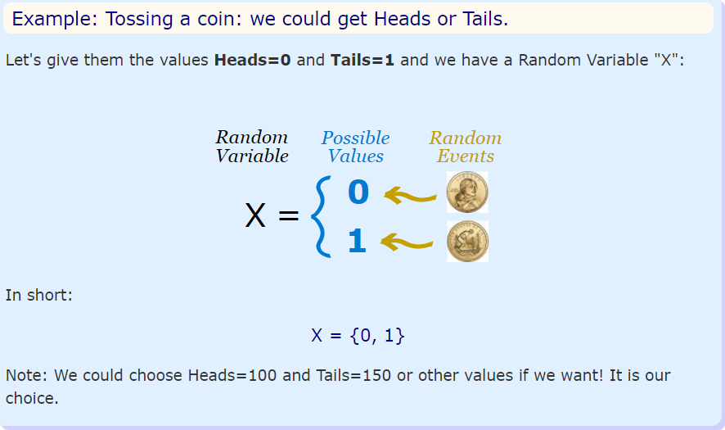
Random Variables
A random variable is a variable whose value is subject to variations due to chance i.e randomness. (also known as stochastic variable). It’s a set of possible values from a random experiment.
A Random Experiment is an experiment whose set of outcomes can be specified beforehand but the actual outcome of the experiment is subject to chance. E.g throwing a dice, flipping a coin etc. The outcome variable of the statistical experiment is usually a random variable.
EVENT is a single result of an experiment
So, we have an EXPERIMENT. We give values to each EVENT of experiment. The set of values is a Random Variable.
Its different from algebraic variable e.g if x+3=7, then x=4. But a random variable is a ‘set’ of values.
X = {1,2,3,4} X could be 1 or 2 or 3 or 4 randomly and each can have different probability of occurrence.

Slide 2
Types of Random Variables
It can be of 3 types:
> Discrete: It can take only integer values e.g [0,1,-1,2,3,4]
> Continuous: It can take any value from a range of values
> Categorical: It can only take a value from a fixed set of values
The actual value of a random variable can not be determined beforehand. However the range of values it can take, can be pre-determined. E.g the roll of a dice, length of a tweet etc

Slide 3
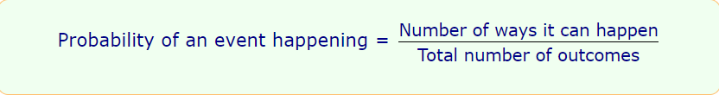
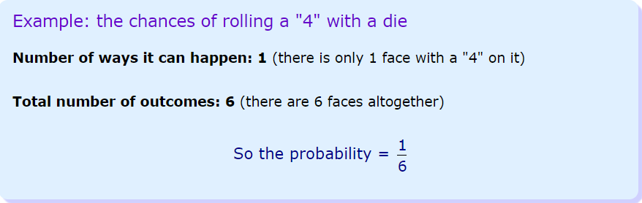
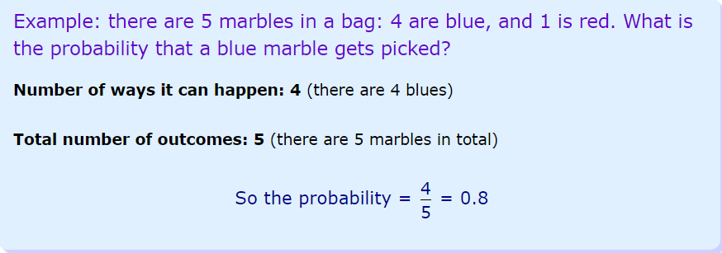
Probability
Probability is a measure of how likely something is to happen

Slide 4
Types of Events
Events can be:
Independent: It is not affected by other events e.g toss os a coin.
Dependent(Conditional): It is affected by other events
Mutually Exclusive: Events can’t happen at the same time

Slide 5
Independent Events
Independent Events are not affected by previous events.
A coin does not "know" it came up heads before.
And each toss of a coin is a perfect isolated thing.
You toss a coin and it comes up "Heads" three times ... what is the chance that the next toss will also be a "Head"? The chance is simply ½ (or 0.5) just like ANY toss of the coin.
What it did in the past will not affect the current toss!
The chances of two or more independent events can be calculated by “multiplying” the probabilities of individual events.
Probability of 3 heads in a row: 0.5 * 0.5 * 0.5 = 0.125
P(A and B) = P(A) × P(B)

Slide 6
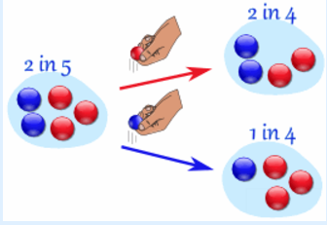
Dependent Events
Dependent Events are affected by previous events.
Example:
Marbles in a bag:
We have 2 blue marbles in a group of 5
Probability(Blue Marble) = 2/5
But after taking one out the chances change!
So the next time:
if we got a red marble before, then the chance of a blue marble next is 2 in 4
if we got a blue marble before, then the chance of a blue marble next is 1 in 4

Slide 7
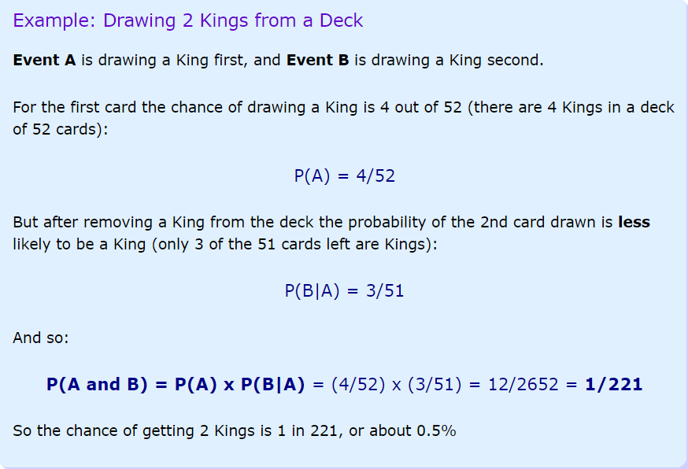
Conditional Probability
In case of Dependent Events, the probability of an event B, “given” that A has happened is known as Conditional Probability or Posterior Probability and is denoted as:
P(B|A)
P(A AND B) = P(A) * P(B|A)
Or
P(B|A) = P(A and B)/P(A)

Slide 8
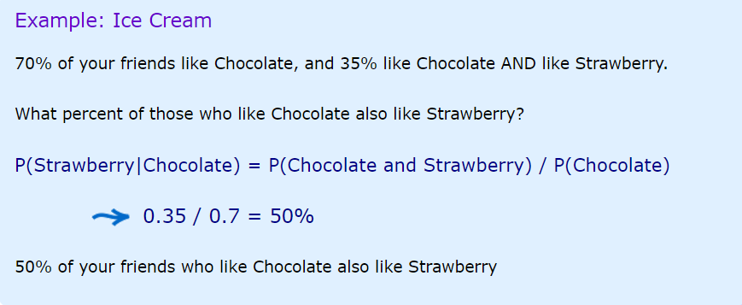
Conditional Probability

Slide 9

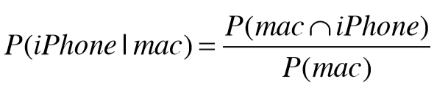
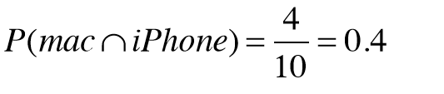
Conditional Probability
Probability that a randomly selected person uses an iPhone:
P(iPhone)= 5/10 = 0.5
What is the probability that a randomly selected person uses an iPhone given that person uses a Mac laptop?
there are 4 people who use both a Mac and an iPhone:
and the probability of a random person using a mac is P(mac)= 6/10
So the probability of that some person uses an iPhone given that person uses a Mac is
P(iphone|mac) = 0.4/0.6 = 0.667

Slide 10
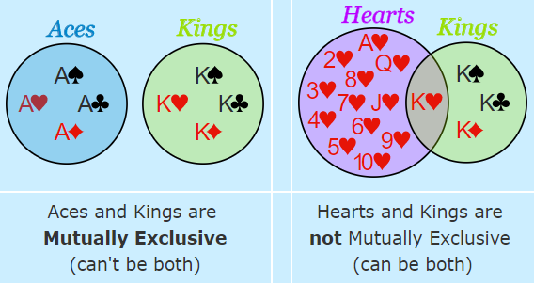
Mutually Exclusive Events
Mutually Exclusive Events are those events which can not happen at same time
You can either go to left or right bit not both at same time
A coin will either turn up Heads or Tails
Kings and Aces are mutually exclusive
Not mutually exclusive events :
Turning left and scratching your head
Kings and hearts in a deck, because we can have a King of Hearts

Slide 11
Probability of Mutually Exclusive Events
If A and B are mutually exclusive, then
P(A and B) = 0
e.g If a card is drawn randomly from a deck, whats the probability that it is King AND Queen? 0
But, we can find out the probability of Event A OR Event B
P(A or B) = P(A) + P(B)
Probability(Card is King OR Card is Queen) = 1/13 + 1/13
In case when events are not mutually exclusive:
P(A or B) = P(A) +P(B) – P(A and B)

Slide 12
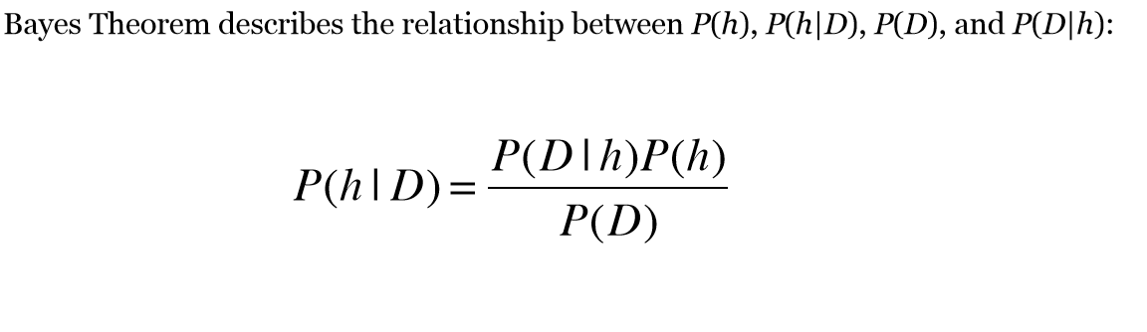
Bayes Theorm
P(D) = P(D|h)*P(h) + P(D|~h)*P(~h)
0.8% of the people in the U.S. have diabetes. There is a simple blood test we can do that will help us determine whether someone has it. The test is a binary one—it comes back either POS or NEG. When the disease is present the test returns a correct POS result 98% of the time; it returns a correct NEG result 97% of the time in cases when the disease is not present.
Suppose a patient takes the test for diabetes and the result comes back as Positive. What is more likely : Patient has diabetes or Patient does not have diabetes?

Slide 13
Bayes Theorem
P(disease) = 0.008
P(~disease) = 0.992
P(POS|disease) = 0.98
P(NEG|disease) = 0.02
P(NEG|~disease)=0.97
P(POS|~disease) = 0.03
P(disease|POS) = ??
As per Bayes Theorm:
P(disease|POS) = [P(POS|disease)* P(disease)]/P(POS)
P(POS) = P(POS|disease)* P(disease)] + P(POS|~disease)* P(~disease)]
P(disease|POS) = 0.98*0.008/(0.98*0.008 + 0.03*0.992) = 0.21
P(~disease|POS) = 0.03*0.992/(0.98*0.008 + 0.03*0.992) = 0.79
The person has only 21% chance of getting the disease

Slide 14
Probability Distribution
A Probability Distribution is a table or function which links each outcome of a statistical experiment with its probability of occurrence.
Lets take a statistical experiment where in we are picking up a user at random from the entire group of Facebook Users. We have the data tracking the country of users which login into facebook each day. Here Country is the random variable. The % users logging in are as follows:
Now we can get the probability if the user picked belongs to USA
P(X=”USA”)= 10/100 = 0.1
If the probabilities of each outcome of a statistical experiment are same, it is said to belong to Uniform Probability Distribution. E.g the experiment of throwing a dice. Each outcome has a probability of 1/6.
Depending upon the type of Random Variable, the probability distribution can also be Discrete or Continuous
Country | % of Users
USA | 10%
India | 7%
Brazil | 5%
Indonesia | 4%
Others | 74%

Slide 15
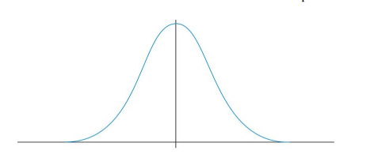
The NORMAL Distribution
In real world, the following type of distribution is very commonly seen:
/
The x-axis is the value of the random variable.
The y-axis is the probability it can take
e.g try measuring the height of the employees in your company. In most situations, there will be couple of employees with very low measurements, couple of employees with very large measurements and most of them centred on a particular value. Since this pattern is so frequently seen, it is called as normal distribution.
The peak value is called the Mean or Average. The width of the curve defines the spread of the variable and is defined by a parameter called “Standard Deviation”
Mean and SD are usually sufficient to completely describe a Normal Distribution. Given these 2 numbers , one can calculate the probability of a random variable by using Standard Tables. But before assuming that a random variable follows Normal Distribution, you need to perform certain tests for Normality

Slide 16
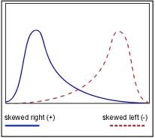
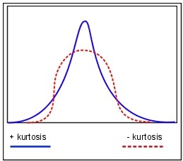
The Normal Distribution
Central Limit Theorem:
Regardless of the underlying distribution, if we draw large enough samples and plot each sample mean then it approximates to normal distribution. The Empirical Rule states that the percentages of data in a normal distribution within 1, 2, and 3 standard deviations of the mean are approximately 68%, 95%, and 99.7%, respectively.
Skewness and Kurtosis are the other two characteristics used to understand a distribution. Skewness is a measure of the asymmetry. Negatively skewed curve has a long left tail and vice versa. Kurtosis is a measure of the "peaked ness". Distributions with higher peaks have positive kurtosis and vice-versa. Following diagrams will make this parameter clearer

Slide 17
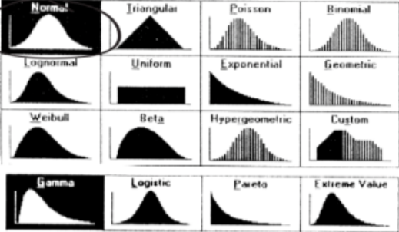
Probability Distributions and ML
The “features” that we select in a Machine Learning problem are generally Random Variables
Many Machine Learning techniques makes assumptions about what are the probability distributions of these random variables
Statisticians and Mathematicians have studied a lot of random variables in nature and realized that there are some recurrent themes. They have defined some standard distributions and most random variables that are encountered fall into one of these standard distributions.

Slide 18
Analytics Landscape
Reporting: A report describes what events have happened in the business. It provides what is asked for and is typically standardized. A monthly sales summary report shows monthly sales by region.
Analysis: An analysis tries to answer why the events happened in the business have happened. E.g an analysis of sales summary report may show sales peaks on specific holidays or weekends. Basic Analytics involves slicing and dicing of data, monitoring large volumes of data in real time and anomaly detection
Advanced Analytics: Advanced analytics extends the insights provided by analytics by doing impact analysis on the business and prescribing the next steps which can be taken. It includes predictive modeling, text analytics and advanced data mining algorithms. The purpose of any "data analysis" is to derive meaningful information from it. One way to extract information from data is to study the variability in data points. The more is the variability, the more careful you have to study or explore the dataset, so that you can capture all of its meaning.
Data Science: Data science is about using data to make decisions that drive actions.
Data science involves:
Finding data
Acquiring data
Cleaning and transforming data
Understanding relationships in data
Delivering value from data
Forecasting is a process of estimating the future based on past events. It’s at a high level. E.g no of calls expected in a call center, no of passengers expected to travel from an airport next month etc
Predictive modeling is doing the prediction or estimation at a more granular level. E.g which customers are expected to buy the printer in next 30 days.

Slide 19
Doing Analytics – Step by Step
Understand the Business Process
Understand the data involved in that Business process – Data Profiling & Exploration
Modeling
Testing and Validation
Deployment

Slide 20
Exploratory Data Analysis
EDA refers to the process of exploring data for the purpose of doing analytics. It is primarily concerned with looking data, summarizing it, find out the main characteristics of data, usually with visual aid.
Identify the dependent and independent variables (Predictor and Target)
Univariate Analysis: For continuous variables, check the distribution/summary of each of your attributes (mean, median, range, inter-quartile range, standard deviation). For categorical variables, use frequency tables to understand the distribution of each category. It can be measured by finding out Count and Count% of each category.
Bivariate Analysis: Find out the relationship between several variables
Handling Missing Values: In cases where you have a lot of data and only a few missing values, it might make sense to simply delete records with missing values present. On the other hand, if you have more than a handful of missing values, removing records with missing values could cause you to get rid of a lot of data. Missing values in categorical data are not particularly troubling because you can simply treat NA as an additional category. Missing values in numeric variables are more troublesome, since you can't just treat a missing value as number.
Handling Outliers
Variable Transformation
Variable Creation

Slide 21
Exploratory Data Analysis
Do I need all of the variables?
2. Should I transform any variables?
3. Are there NA values, outliers or other strange values?
4. Should I create new variables?

Slide 22
Handling Missing Values
1. If the dataset contains very less no of missing values, you can drop those records
2. Replace the null values with 0s
3. Replace the null values with some central value like the mean or median
4. Impute values (estimate values using statistical/predictive modeling methods.).
5. Split the data set into two parts: one set with where records have an Age value and another set where age is null.

Slide 23
Plots for Data Exploration
Histogram: A histogram is a univariate plot (a plot that displays one variable) that groups a numeric variable into bins and displays the number of observations that fall within each bin. A histogram is a useful tool for getting a sense of the distribution of a numeric variable.
Boxplot: Boxplots are another type of univariate plot for summarizing distributions of numeric data graphically. They can very clearly show outliers in data. The central box of the boxplot represents the middle 50% of the observations, the central bar is the median and the bars at the end of the dotted lines (whiskers) encapsulate the great majority of the observations. Circles that lie beyond the end of the whiskers are data points that may be outliers.
Scatterplot: Scatterplots are bivariate (two variable) plots that take two numeric variables and plot data points on the x/y plane.

